Slide 1

Student Grade Management System

Slide 2

Introduction and Background
Problem: Manual grade management is slow and error-prone
Need: Efficient automated system
Solution: Python-based grade management system

Slide 3

Algorithms Used:
- Merge Sort
- Binary Search
1
Design & Implementation
2
Features:
- Data entry loop
- Case-insensitive search

Slide 4
Workflow:
Data Entry: A dynamic loop collects student names and grades until the user inputs 'stop'.
Structural Organization: The list is sorted using the "Divide and Conquer" strategy of Merge Sort.
Search Mechanism: The system sorts names alphabetically first to allow Binary Search to function correctly.
Challenges: Handling non-uniform text input. We resolved this by using the .lower() function to make the search case-insensitive.

Slide 5
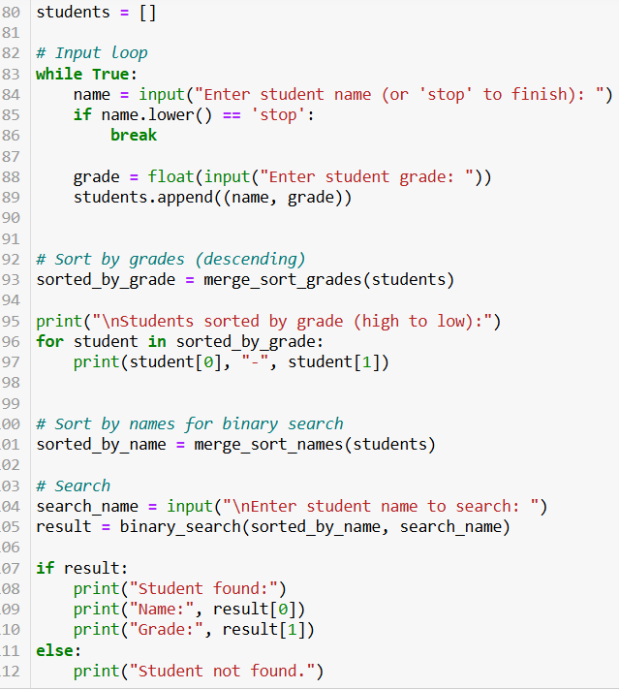
source code

Slide 6
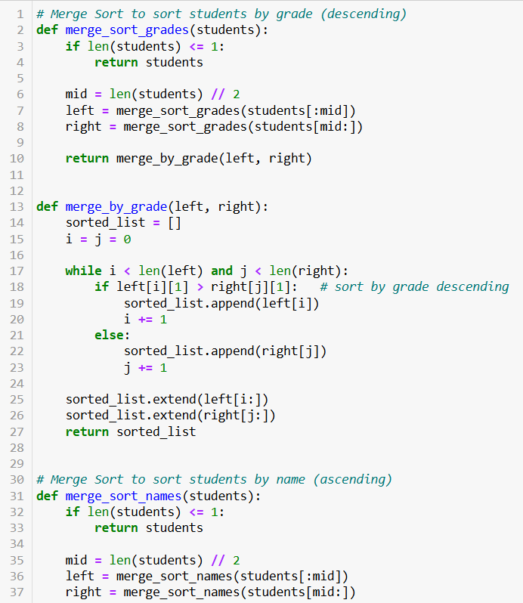
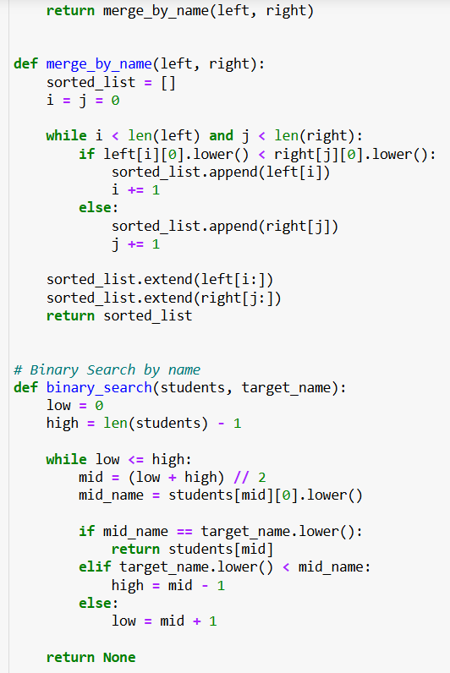
source code

Slide 7

Optimization Strategies
1 2 3 4
Removed redundant code
Generalized merge sort
Preserved O(n log n) complexity
Improved usability

Slide 8
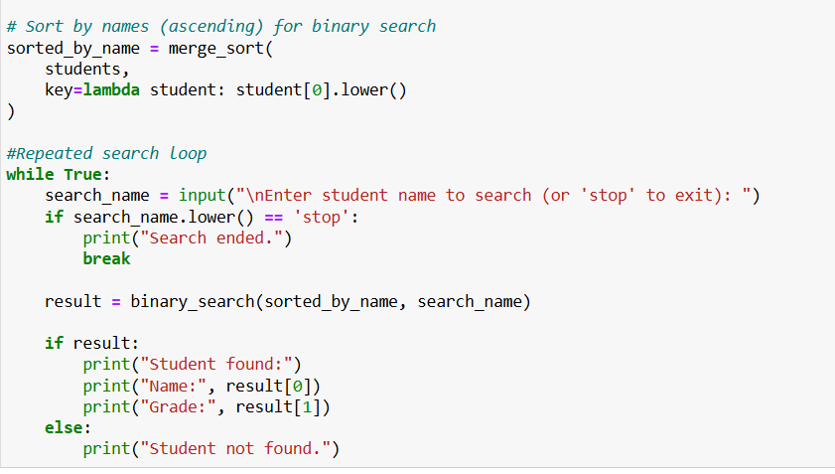
optimized version

Slide 9
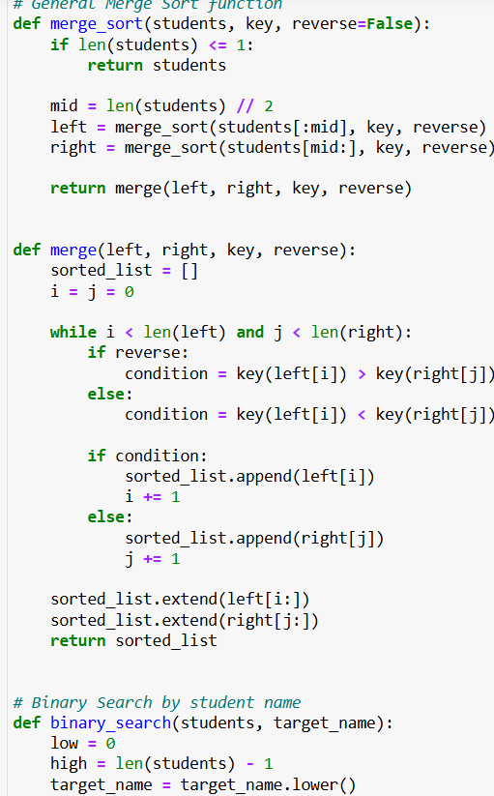
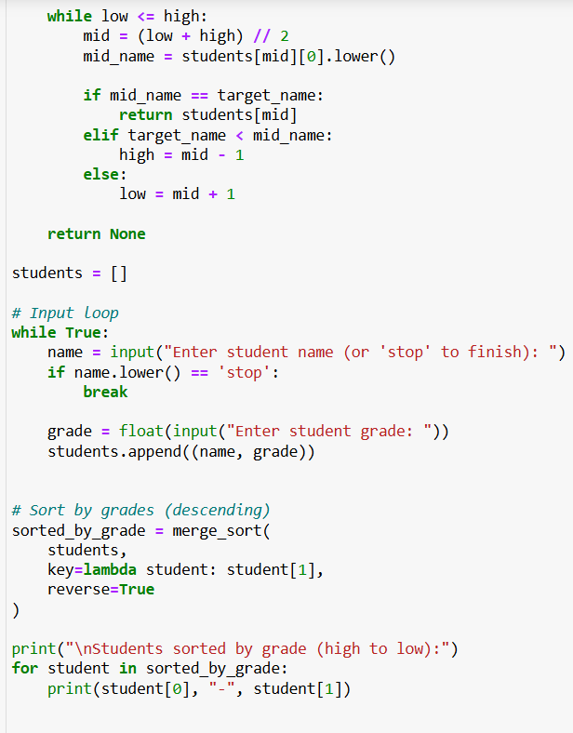
optimized version

Slide 10

RESULTS
Sorting: O(n log n)
Searching: O(log n)
Improved speed, accuracy, and scalability

Slide 11

Future Work
Save to Excel/CSV
- GUI development
- Advanced analytics

Slide 12

Conclusion
Fast and reliable grade management

Slide 13
THANK YOU
VISIT US
.

